Slide 1



Home on the Hill Playbook
September 23, 2018

Slide 2
HOME ON THE HILL PLAYBOOK
Contents
Key Issues Encountered
Potential Collaborators or Competitors
Competitive Analysis
Survey Results
Financial Analysis
Demographic Analysis

Slide 3
Key Issues Encountered

Slide 4
WHAT’S NEXT?
Key issues encountered
Board
Data
Financials
Lack of alignment across board members along with poor retention rates
Lack of metrics to track progress (also required as a tool for funding)
Between February and May of 2018, HOH reduced their monthly support program offerings from 29 in February 2018 to 16 in May 2018
HOH spends a lot of resources applying for funding through Central LHIN
Home on the Hill’s operating annual budget amounts to approximately $20,000.

Slide 5
Potential Collaborators or Competitors

Slide 6
PLAYBOOK
Potential Partners – York Region Community Partners
HOH should investigate the potential of partnering with a wide variety of community groups
York Region Community Organizations By Type | Commentary
 | Over 100 community organizations are active in York Region that express a potential desire for partnership with HOH While the focus of these groups varies, they may have complementary activities that can be leveraged by both organizations.
 | Example Organizations
2
Type | Examples
Mental Health | Schizophrenia Society of Canada, Krasman Centre, Catholic Community Services of York Region
Health Services | All-Care, Health & Staffing Services, Health Care Services, Richmond Health Centre
Community Health Centers | Ontario Shores, Southlake Regional Health Centre, Blue Hills Child and Family Services LOFT Cross Links
(1) Source: CIVICYork – Community Information and Volunteer York Region,; website:https://york.cioc.ca/ . (2) Includes organizations and regional overarching organizations
Notes:
‹#›

Slide 7














PLAYBOOK
Potential Partners – York Region Community Partners
HOH should investigate the potential of partnering with a wide variety of community groups
Partnership Rationale | Group Types | Approach
Group is well-connected in the community, has an interest in serving community's best interest Group is involved in community activities and can be partnered with to promote the HOH message | Health Centers | Ask for introductions in connecting with others in the community who may be able to assist in furthering the message or in reaching those in need to services
Word of mouth is one the most efficient ways to increase referral rates | Health Professional Health Services | Visible presence in group locations (flyers, posters, etc) Ask for referrals, where appropriate, of Clients in need of HOH services
Group is providing complementary services and putting HOH on the map for a particular region | Mental Health (regional organizations) Mental Health (local organizations) | Ask for inclusion in regional services database such as Central LHIN, CMHA York Region etc. Ask for educational resources for HOH catchment area
Notes:
‹#›

Slide 8
PLAYBOOK
Potential Partners – York Region Community Partners
HOTH should investigate the potential of partnering with a wide variety of community groups
Group Type | Potential Partner
 | Name | Why
Health Centers | Krasman Centre | To offer joint unique programs, to share space, to advertise events to local community, Caregiver Programs could be enhanced by teaming up with Krasman Centre
 | Ontario Shores Centre for Mental Health Sceinces | Ontario Shores specializes in Mental Health Sciences, a better opportunity to address common mental health needs. Also a mental health Education resource.
 | Southlake Regional Centre | Aurora (additional chapters in surrounding communities)
 | LOFT/Crosslinks Housing and Support Services | LOFT offers a range of services to a wide audience. Robert Veltheer lecture series could be advertised. Case Management and Community Integration services could be leveraged
Health Professionals and Services | Mackenzie Health | Partnership with a local hospital would generate referrals to programs in demand. Would enable local visibility
 | Markham - Stouffville | Partnership good for long term growth and education of the local community.
Organizations (Local and Regional) | Canadian Mental Health Association CMHA | Programs offered are. MOBYSS – Mobile Walk in Clinic, Case Management Services. Partnerships could be formed for Family and Caregiver Group. For training Mental Health First Aid Basic (2-days) is offered by CMHA
 | Alzheimer Society of York Region | Partnerships for family caregiver programs or lecture series.
 | Belinda's Place | Belinda’s Place is women only organization, focused on transitional programs, case management, housing outreach.
 | Blue Door Shelters | Wide range of services offered and a large partner network
 | Elizz - All Things Caregiving | Strong expertise in Caregiving.
Online Resources | Online Support through Big White Wall https://www.ontarioshores.ca/ | A round-the-clock online peer support community where members can share experiences and express themselves in words and images, helping participants feel less socially isolated
 | CareGiver Exchange | An online platform for caregivers.
Notes:
‹#›

Slide 9
PLAYBOOK
Corporate Partners
York Region Employers By Sector¹ Segmented by # of employees; as of 2016 | Commentary
 | There are over 30,000 employers in the York Region, encompassing a wide array of industry sectors Roughly 2/3^{rds} of the firms have fewer than 50 employees
 | Major Employers
5,292
3,755
3,325
3,126
2,895
2,647
2,580
1,782
1,366
1,270
975
806
608
526
Sector | Examples
Health care and social assistance | Canadian Health Mental Association, United Way, Region of York, Ontario Ministry of Health Promotion and Sport, Salvation Army, Ontario Trillium Foundation
Educational Services | York Region Board of Education, Seneca, Community Education Centre-Central, York Region District School
Accommodation and Food Services | McDonalds, The Keg, Hilton, Sheraton
356
206
194
30
20
10
# of employees
(1) Source: 2016 York Region Business Directory, website: http://www.yorklink.ca/york-region-interactive-business-information/; excludes 1,424 employers with no NAICS code or # of employees
Notes:
‹#›

Slide 10
PLAYBOOK
Corporate Partners
Recommend focusing on three types of employers – in the Retail Trade, Manufacturing, and Accommodation and Food Services sectors
Segment | Rationale | Messaging
Health Care and Social Assistance | Strong population of medium-to-large firms, meaning greater scalability of potential partnerships Large number of smaller firms to partner with should provide a more targeted approach be utilized | Message: promotion of flagship program and advocacy for mental health. Seek collaboration on unique program offerings.
Educational Services | Moderate population of medium-to-large firms, meaning some potential to scale partnership referrals with one point of contact | Message: ensure firm is aware of mental health awareness services offered; partner with subject matter experts from health related fields
Accommodation and Food Services | Strong population of medium-to-large firms, meaning greater scalability of potential partnerships Could be used for catering for events such as Robert Veltheer Series | Message: seek collaboration on programs related to health and wellness. Promotion through flagship programs
Segment | Potential Partner
 | Name
Health Care and Social Assistance | Canadian Health Mental Association , United Way, Region of York, Ontario Ministry of Health Promotion and Sport, Salvation Army, Ontario Trillium Foundation, Hockey helps the homeless,
Educational Services | York Region Board of Education, Seneca, Community Education Centre-Central, York Region District School
Accommodation and Food Services | McDonalds , Tim Horton’s, Cora’s Breakfast and Lunch, Local Deli’s and Bakery
Notes:
‹#›

Slide 11
PLAYBOOK
Suggested Implementation Ideas ** WORKING**
Create meaningful partnerships within the region to create more referrals and mental health awareness
Segment | Near term Within 90 days | Mid-term 3 -9 months | Long-term 9 months +
Partnerships | Develop partner assessment framework to rank partnership opportunities Identify potential partners leveraging York Region business directory in the region Assess resources required and what will be required. | Prepare a final partner package that outlines -what can the partner expect from HOH Approach potential partners a partnership with local companies/social agencies to build awareness and engagement in your organization | Assess value of partnership on a regular basis, considering resourcing required to support vs referrals Where appropriate, look to deepen partnerships, such as through representation on the board.
Notes:
‹#›

Slide 12
Competitive Analysis

Slide 13
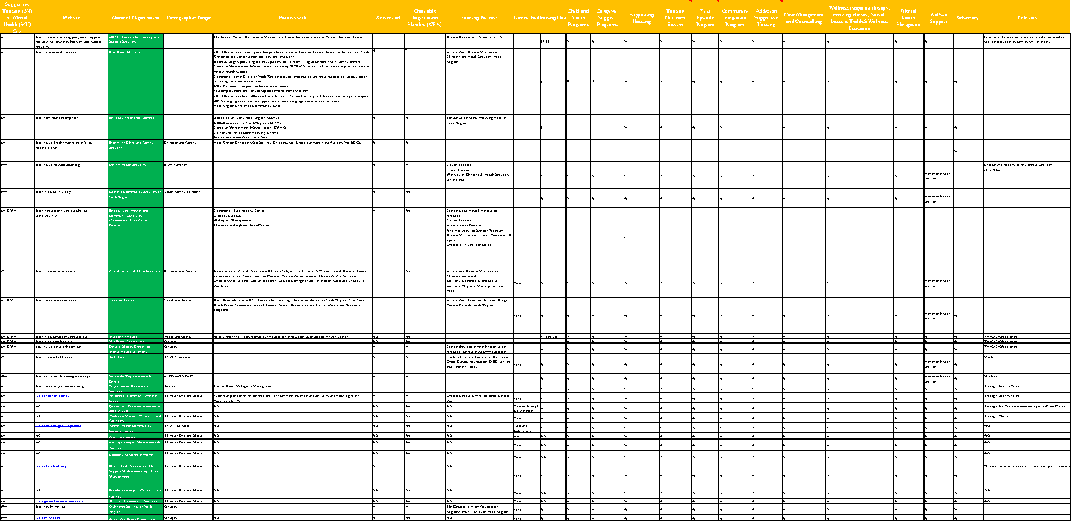
PLAYBOOK
Competitive Analysis
Notes:
‹#›

Slide 14
Survey Results

Slide 15
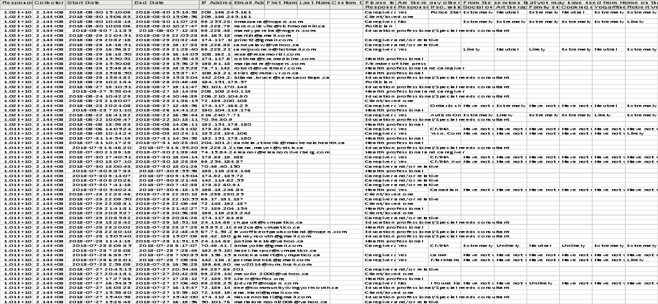
PLAYBOOK
Survey Results
Notes:
‹#›

Slide 16
Financial Analysis

Slide 17
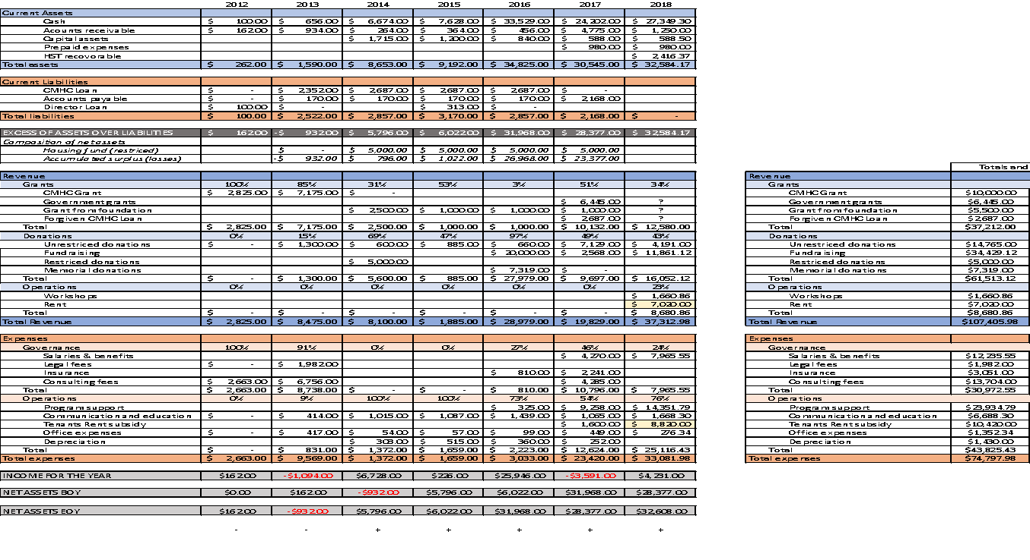
PLAYBOOK
Financial Analysis
Notes:
‹#›

Slide 18
Demographic Analysis

Slide 19
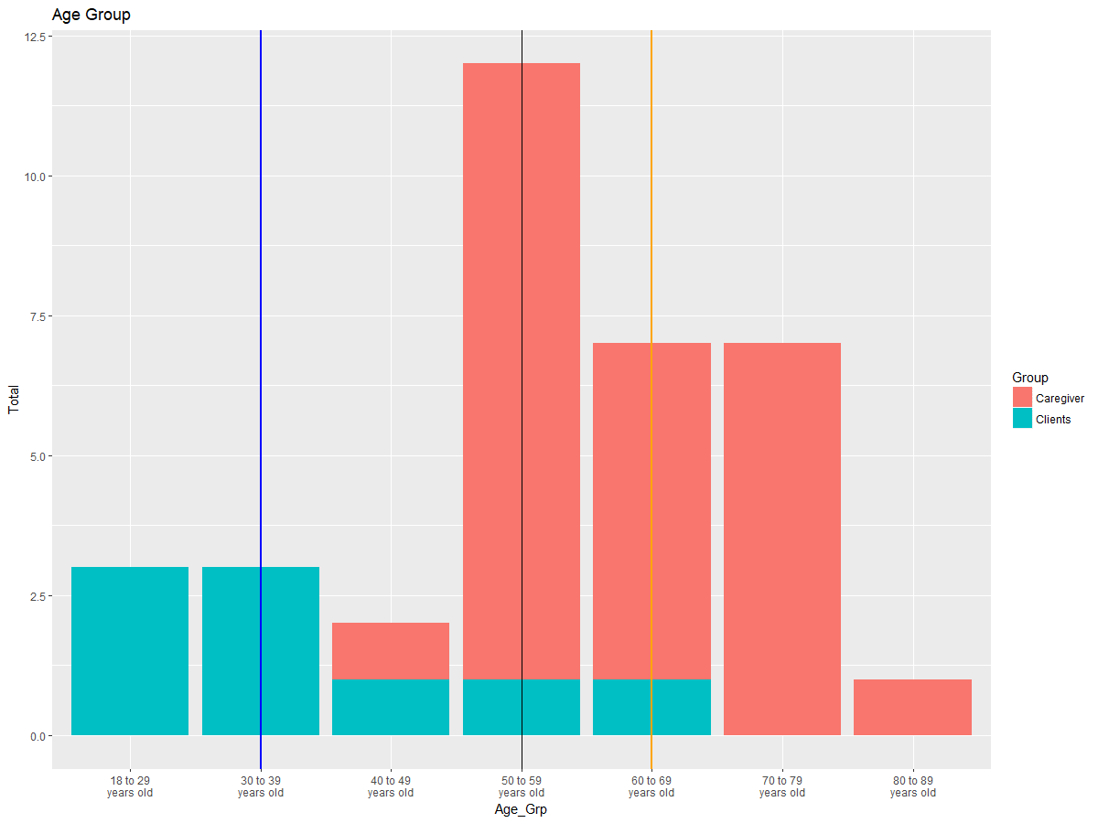
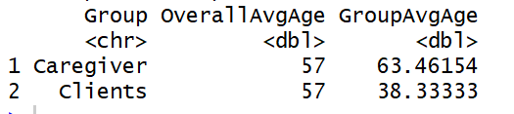
PLAYBOOK
Age
Key Finding: Client groups are young adults
Overall Avg
Key Finding: Most Caregivers are senior
Clients Group Avg
Caregiver Group Avg
Notes:
‹#›

Slide 20
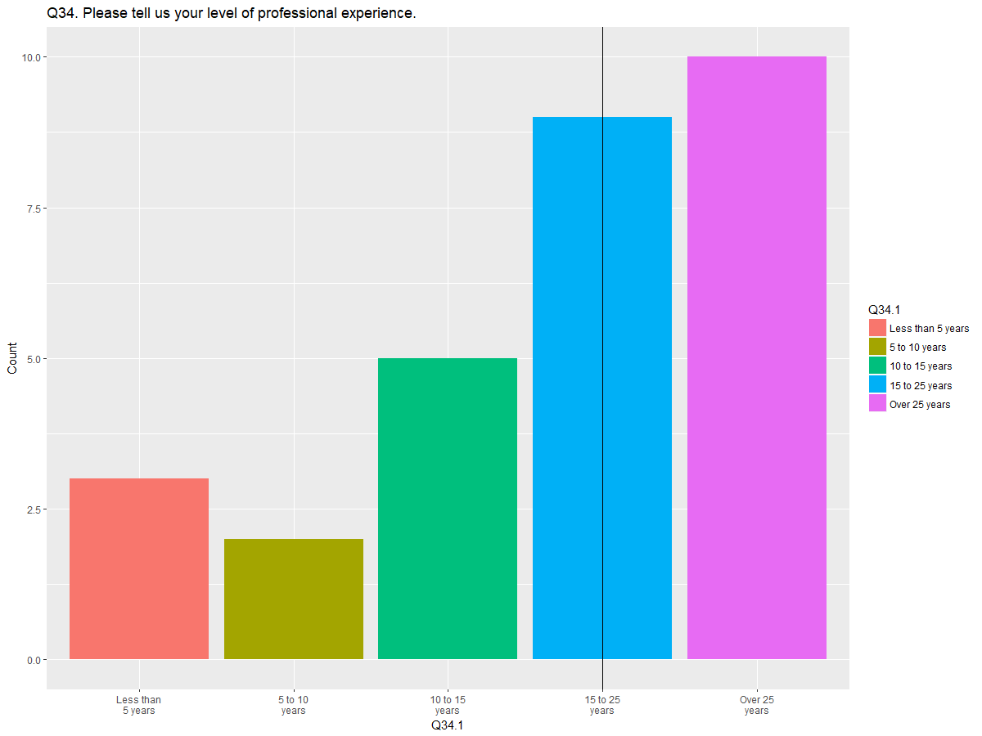
PLAYBOOK
Professional Experience
Key Finding: Very experience profession can be seen in HOH.
Notes:
‹#›

Slide 21
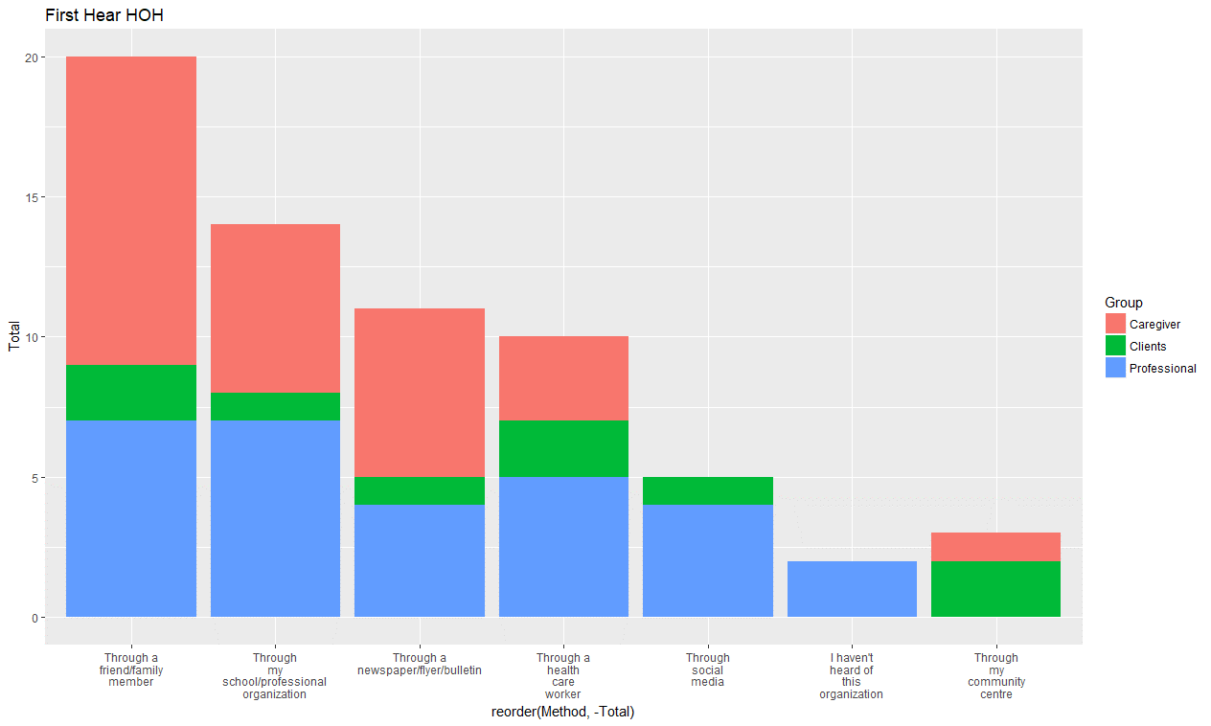
PLAYBOOK
How did you hear of Home on the Hill?
Key Finding : Heavy focus on word by mouth
Notes:
‹#›

Slide 22
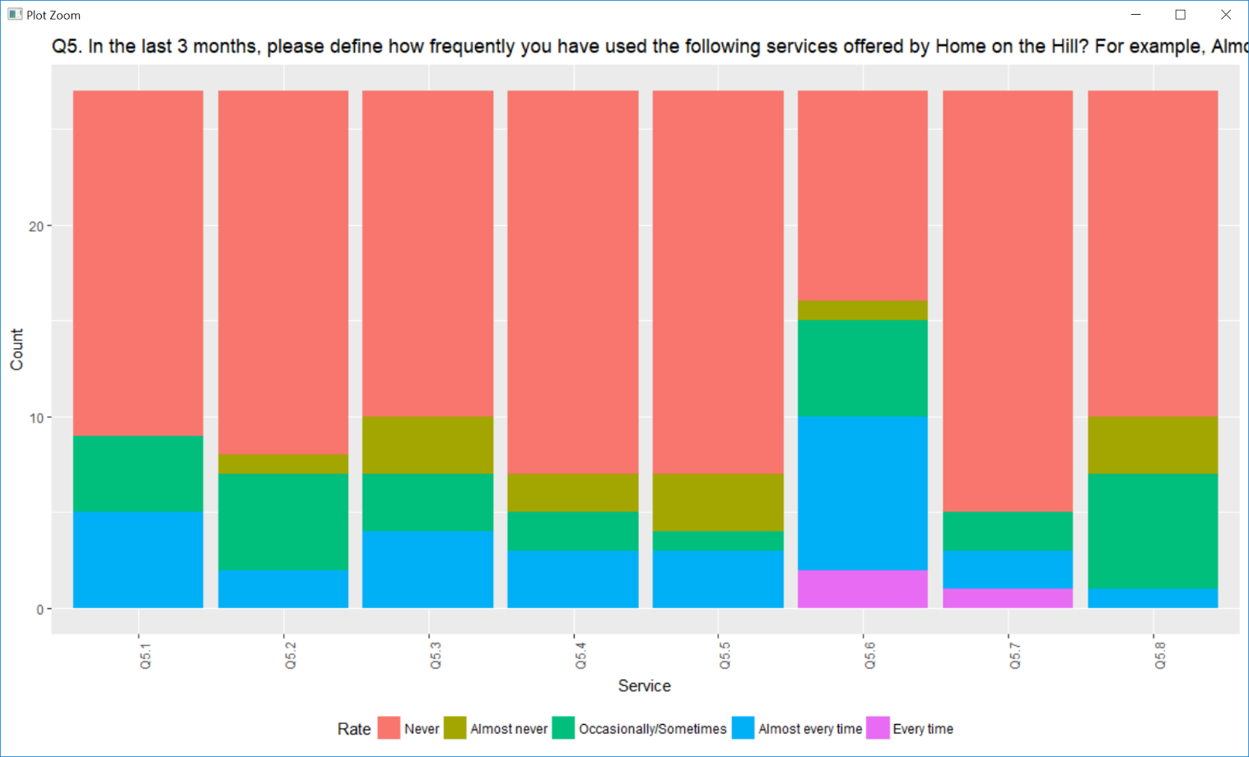
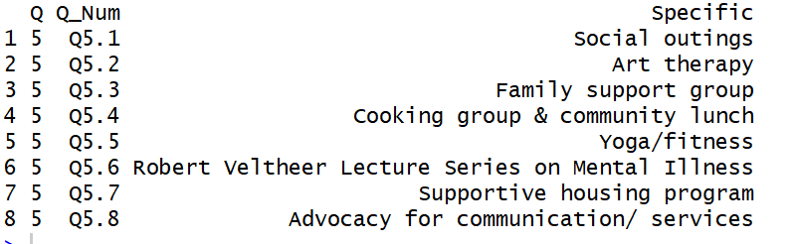
Participation
PLAYBOOK
Key Finding: Very low participation rate. Lecture series seems the favour event
Notes:
‹#›

Slide 23
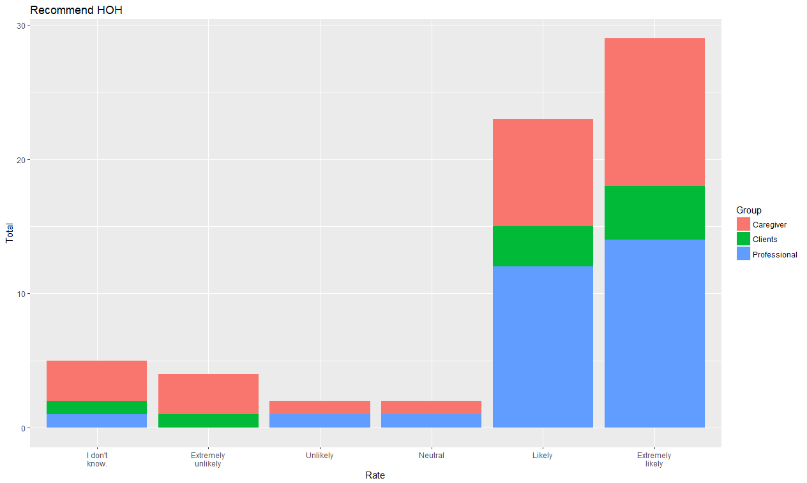
Recommendation
PLAYBOOK
Key Finding : Very high rating to HOH.
Notes:
‹#›

